Slide 1
Social Robotics 2
Weekly Report for 12-16 April 2021
Social Interactivity Mentor for Youth with Autism using the NAO Robot (SIMYAN)
Andrew Nguyen | Bryce George | Colton Homuth | William Ross
Sponsor - Dr. Adham Atyabi
Faculty Advisor - Mr. Bill Michael
April 16, 2021

Slide 2
Development Accomplishments
Speech events system
Raise events when particular words are heard
Progress with vision system
Converting image to drawing spec
Robot able to draw a triangle
Replay captured position data

Slide 3
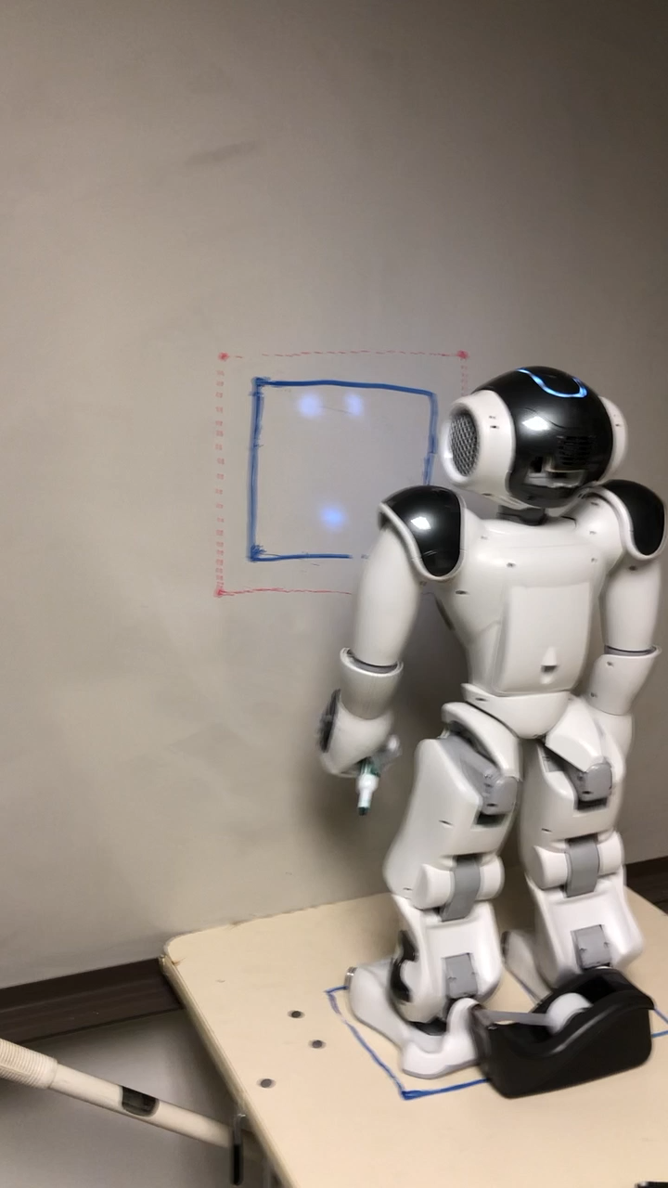
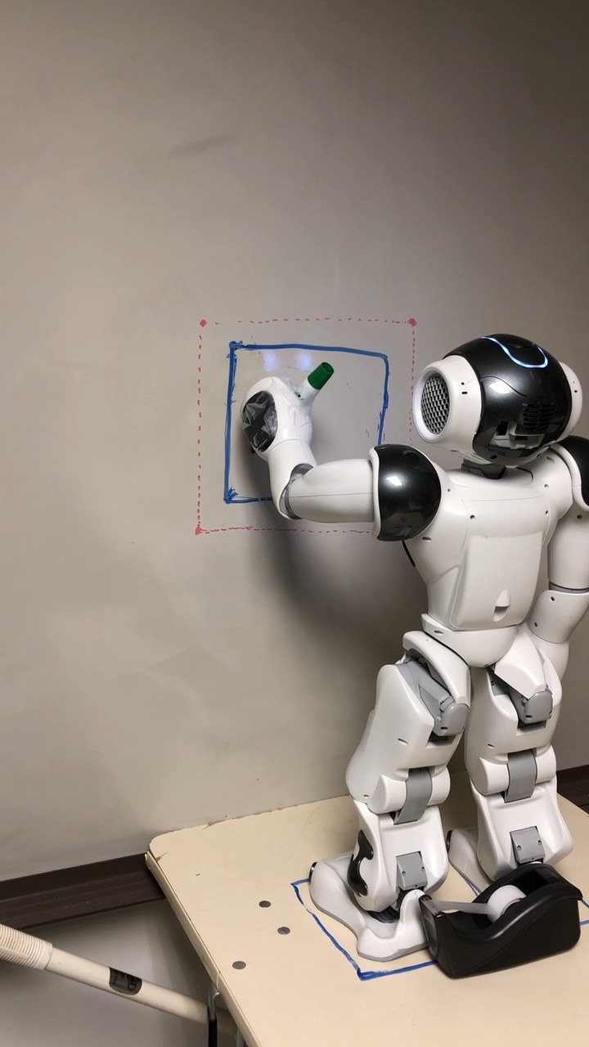
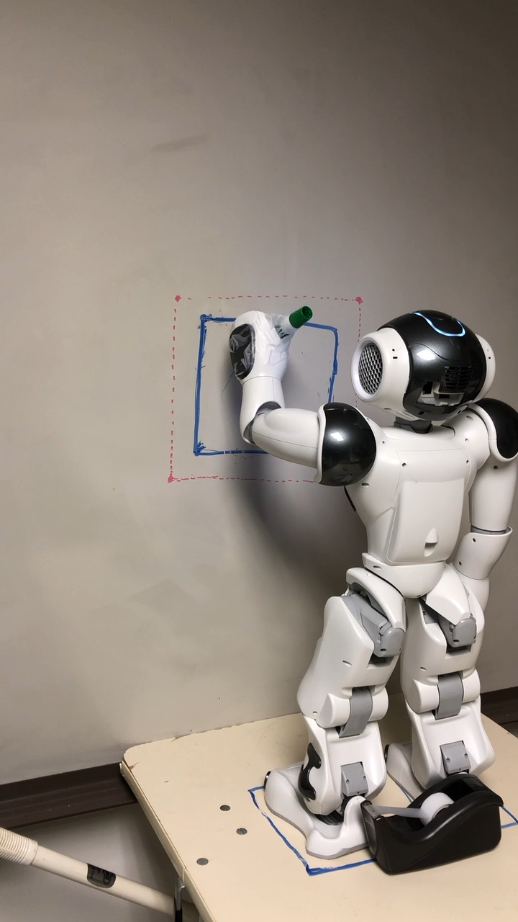
Drawing Demo (1)

Slide 4
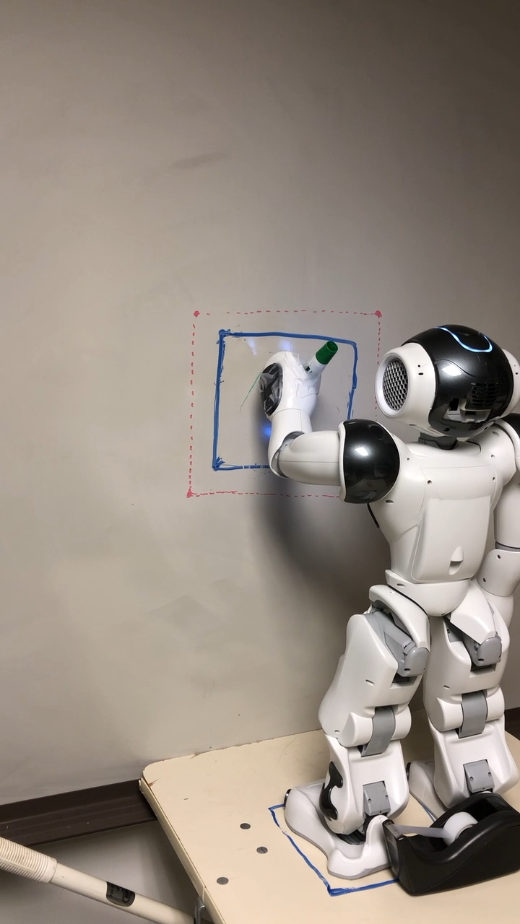
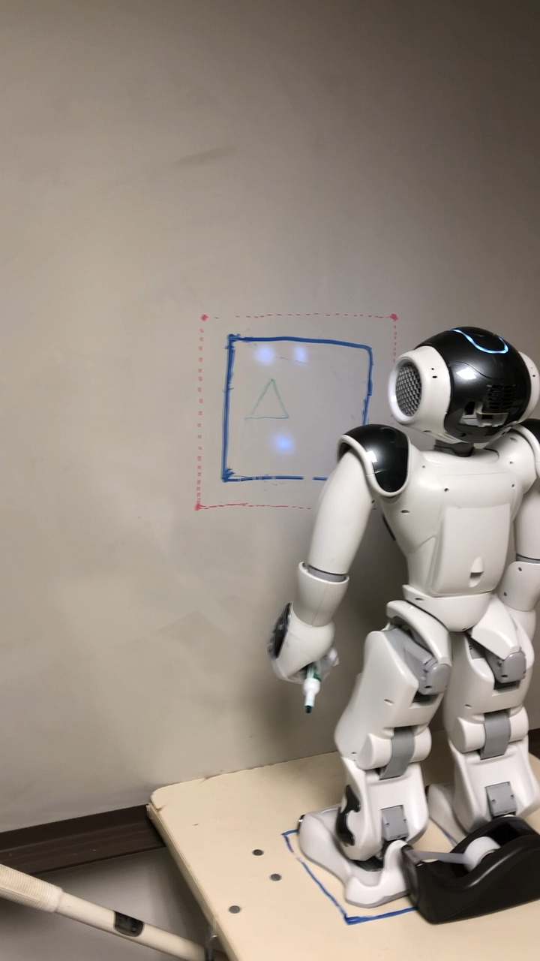
Drawing Demo (2)

Slide 5
Impediments
Schedule/Workload
Conflicts from work, class, and extracurricular schedules
Poor NAOqi Documentation
Cartesian API tutorials missing required steps
Speech Recognition API tutorials missing required steps
General lack of specificity for a significant number of methods in API docs

Slide 6
Project Status
Current Phase: Extended Development and Testing
Started: 4/10
Ends: 4/25
Current Sprint: 5 (of 6)
Started: 4/10
Ends: 4/18 (development); 4/25 (testing)
Days Remaining: 10
Epics:
Core SDK [CRITICAL]
Activities Master Module [In Progress – 90%]
Adv. Speech Recognition Module [In Progress – 90%]
Adv. Motor Control Module [In Progress – 85%]
Adv. Computer Vision Module [In Progress – 85%]
Drawing Activity [CRITICAL]
Drawing Specification Generator [In Progress < 50%]
Activity User Interaction Flow [In Progress – 10%]
Motor Control Integration [Blocked]
Vision Integration [Blocked]
Speech Integration [Blocked]
Kinect Integration [Iceboxed]

Slide 7
Any Questions?

